Slide 1


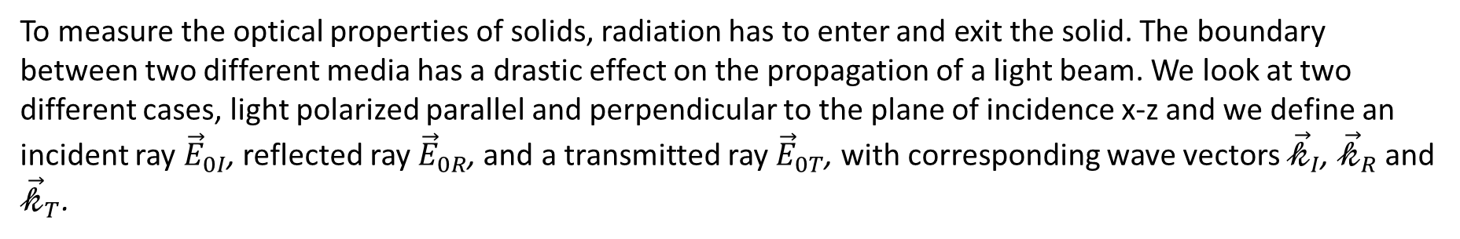




1.2 Fresnel’s equations
To measure the optical properties of solids, radiation has to enter and exit the solid. The boundary between two different media has a drastic effect on the propagation of a light beam. We look at two different cases, light polarized parallel and perpendicular to the plane of incidence x-z and we define an incident ray ${\vec{E}}_{0I}$, reflected ray ${\vec{E}}_{0R}$, and a transmitted ray ${\vec{E}}_{0T}$, with corresponding wave vectors ${\vec{𝓀}}_{I}$, ${\vec{𝓀}}_{R}$ and ${\vec{𝓀}}_{T}$.
${\vec{E}}_{0}$ perpendicular (TE mode)
${\vec{E}}_{0}$ parallel (TM mode)
$$n_{I}$$
$$n_{T}$$
$$n_{I}$$
$$n_{T}$$

Slide 2





The laws of reflection and refraction
$$ω_{I}=ω_{R}=ω_{T}=ω$$
First take the case of ${\vec{E}}_{0}$ being perpendicular to the plane of incidence, in the example above ${\vec{E}}_{0}=\left(0, E_{0y},0\right)$. The temporal dependence is the same for all rays, since $ω$ is the same in all media.
$$E_{Iy}=E_{0I}e^{i𝓀_{I}(x∙sinθ_{I}+z∙cosθ_{I})}$$
$$E_{Ry}=E_{0R}e^{i𝓀_{I}(x∙sinθ_{R}−z∙cosθ_{R})}$$
$$E_{Ty}=E_{0T}e^{i𝓀_{T}(x∙sinθ_{T}+z∙cosθ_{T})}$$
The tangential component ${\vec{E}}_{0}$ is continuous across the boundary. At z=0 (the interface lies on the x-axis) we have :
$$E_{0I}e^{i𝓀_{I}(x∙sinθ_{I})}+E_{0R}e^{i𝓀_{I}(x∙sinθ_{R})}=E_{0T}e^{i𝓀_{T}(x∙sinθ_{T})}$$
This is only possible if the exponential terms are equal:
$θ_{I}=θ_{R}$ the law of reflection
$𝓀_{I}∙sinθ_{I}=𝓀_{T}∙sinθ_{T}$ or $\frac{ω}{c}n_{I}∙sinθ_{I}={\frac{ω}{c}n}_{T}∙sinθ_{T}$ or $\frac{sinθ_{I}}{sinθ_{T}}=\frac{n_{T}}{n_{I}}=n_{rel}$ Snell’s law of refraction

Slide 3
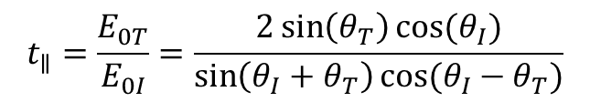

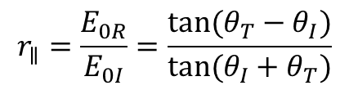
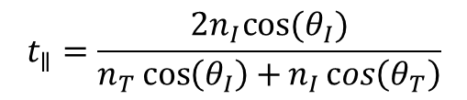
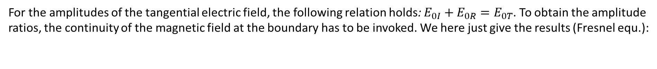

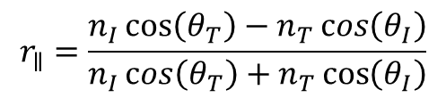
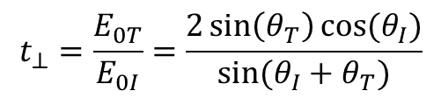
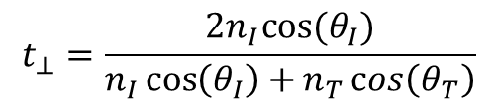
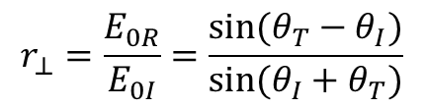
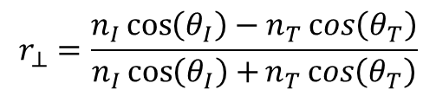
The Fresnel equations
For the amplitudes of the tangential electric field, the following relation holds: $E_{0I}+E_{0R}=E_{0T}$. To obtain the amplitude ratios, the continuity of the magnetic field at the boundary has to be invoked. We here just give the results (Fresnel equ.):
${\vec{E}}_{0}$ perpendicular to the plane of incidence
${\vec{E}}_{0}$ parallel to the plane of incidence
$$r_{⊥}=\frac{E_{0R}}{E_{0I}}=\frac{sin⁡(θ_{T}−θ_{I})}{sin⁡(θ_{I}+θ_{T})}$$
$$r_{∥}=\frac{E_{0R}}{E_{0I}}=\frac{tan⁡(θ_{T}−θ_{I})}{tan⁡(θ_{I}+θ_{T})}$$
(16)
(17)
$$t_{⊥}=\frac{E_{0T}}{E_{0I}}=\frac{2\sin\left(θ_{T}\right)cos⁡(θ_{I})}{sin⁡(θ_{I}+θ_{T})}$$
$$t_{∥}=\frac{E_{0T}}{E_{0I}}=\frac{2\sin\left(θ_{T}\right)cos⁡(θ_{I})}{\sin\left(θ_{I}+θ_{T}\right)cos⁡(θ_{I}−θ_{T})}$$
A different formulation is often found and can be obtained using the trigonometric add. theorem:
$$r_{⊥}=\frac{n_{I}\cos\left(θ_{I}\right)−n_{T}\cos\left(θ_{T}\right)}{n_{I}\cos\left(θ_{I}\right)+n_{T}\cos\left(θ_{T}\right)}$$
$$r_{∥}=\frac{n_{I}\cos\left(θ_{T}\right)−n_{T}\cos\left(θ_{I}\right)}{n_{I}\cos\left(θ_{T}\right)+n_{T}\cos\left(θ_{I}\right)}$$
(16’)
(17’)
$$t_{⊥}=\frac{2n_{I}cos⁡(θ_{I})}{n_{I}\cos\left(θ_{I}\right)+n_{T}\cos\left(θ_{T}\right)}$$
$$t_{∥}=\frac{2n_{I}cos⁡(θ_{I})}{n_{T}\cos\left(θ_{I}\right)+n_{I}\cos\left(θ_{T}\right)}$$
$r=\frac{E_{0R}}{E_{0I}}$ is the reflection coefficient, while $t=\frac{E_{0T}}{E_{0I}}$ is the transmission coefficient. $R=r^{2}$ and $T=1−R$ are the reflectance and transmittance, respectively (intensity is proportional to $E^{2}$).

Slide 4
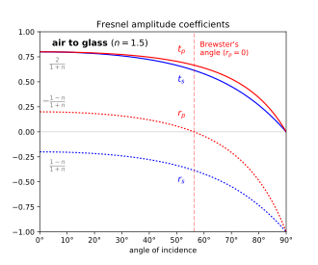
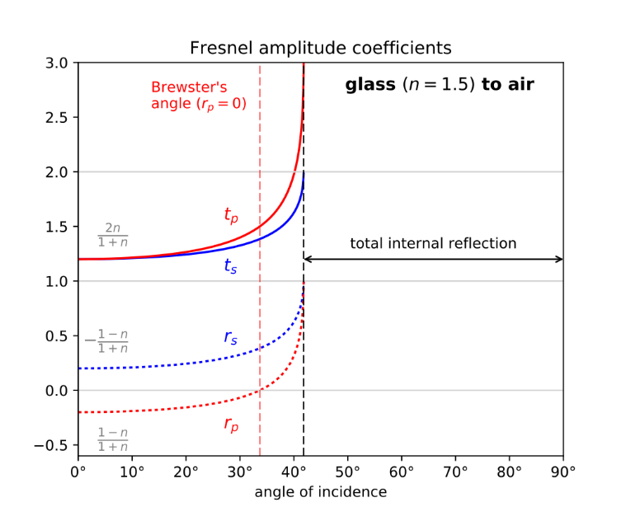
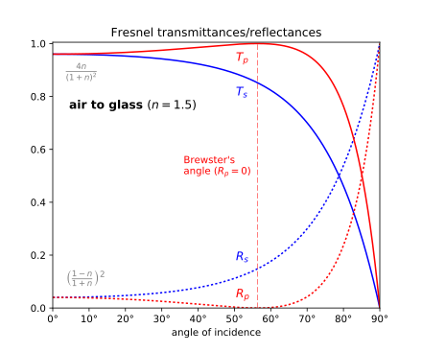
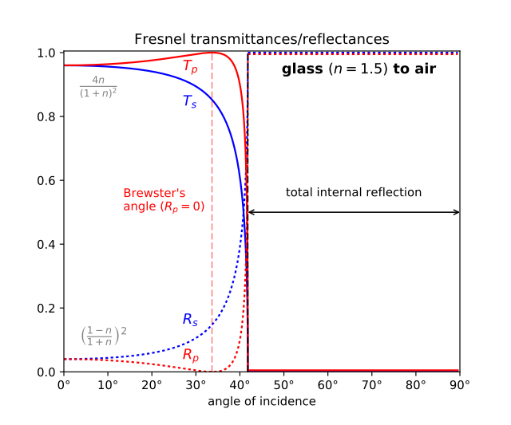





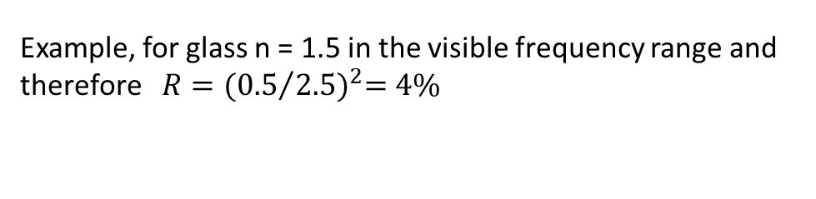







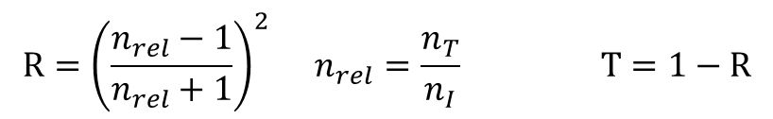











Non absorbing Media
For small angles $θ_{I}$ and $θ_{T}$, $r_{⊥}=r_{∥}$ and non absorbing, homogeneous, isotropic and non-magnetic media:
$$R={\left(\frac{n_{rel}−1}{n_{rel}+1}\right)}^{2} n_{rel}=\frac{n_{T}}{n_{I}} T=1−R$$
Example, for glass n = 1.5 in the visible frequency range and therefore $R={({0.5}/{2.5})}^{2}=4\%$
$$θ_{B}$$
$$θ_{B}$$
$$θ_{tot}$$
$$θ_{B}$$
$$θ_{B}$$
$$θ_{tot}$$
$$t_{∥}$$
$$T_{∥}$$
$$T_{⊥}$$
$$T_{∥}$$
$$t_{∥}$$
$$T_{⊥}$$
$$t_{⊥}$$
$$t_{⊥}$$
$$r_{∥}$$
$$r_{⊥}$$
$$R_{⊥}$$
$$r_{⊥}$$
$$R_{⊥}$$
$$r_{∥}$$
$$R_{∥}$$
$$R_{∥}$$
$$θ_{I}(°)$$
0°
10°
20°
30°
40°
50°
60°
70°
80°
90°
$$θ_{I}(°)$$
$$θ_{I}(°)$$
$$θ_{I}(°)$$
We also see that for $θ_{I}>θ_{T}$ (TE mode), $E_{0R}\sim −E_{0I}$ which means that there is a phase change of $π$ for the reflection at the dense medium. Not so for the reflection at the thinner medium. (This will be relevant for interference phenomena).

Slide 5
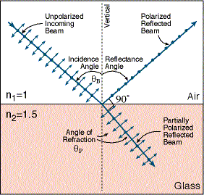

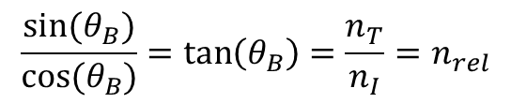

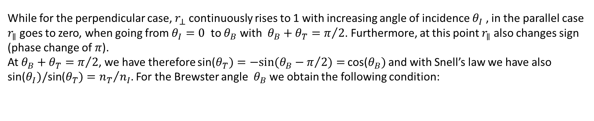


Brewster angle
While for the perpendicular case, $r_{⊥}$ continuously rises to 1 with increasing angle of incidence $θ_{I}$ , in the parallel case $r_{∥}$ goes to zero, when going from $θ_{I}=0$ to $θ_{B}$ with $θ_{B}+θ_{T}=π/2$. Furthermore, at this point $r_{∥}$ also changes sign (phase change of $π$).
At $θ_{B}+θ_{T}=π/2$, we have therefore sin($θ_{T})=−sin(θ_{B}−π/2)=$ cos($θ_{B})$ and with Snell’s law we have also sin($θ_{I})/\text{sin}\text{(}θ_{T})={n_{T}}/{n_{I}}$. For the Brewster angle $θ_{B}$ we obtain the following condition:
$$\frac{sin⁡(θ_{B})}{cos⁡(θ_{B})}=\tan\left(θ_{B}\right)=\frac{n_{T}}{n_{I}}=n_{rel}$$
(19)
$$θ_{B}$$
$$n_{I}=1$$
$$n_{T}=1.5$$
(for glass with n=1.5, $θ_{B}=56.31°$)
$$θ_{T}$$
In conclusion, the reflected beam at $θ_{B}$will be polarized with the electric field being perpendicular to the plane of incidence. This has application in spectroscopy (Brewster angle spectroscopy) or generally antireflective glasses.

Slide 6
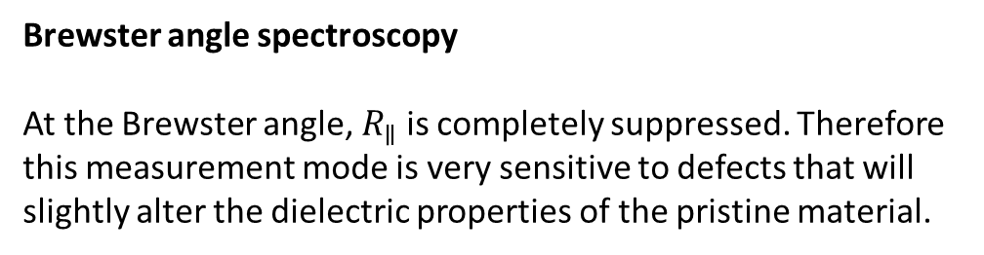
Applications of Brewster angle phenomenon
Brewster angle microscopy (BAM)
For very thin layers on a solid or liquid support (e.g. on a Langmuir trough), the incident angle of the microscope can be chosen to be the Brewster angle. For light polarized parallel to the plane of incidence (TM), reflectance from the supporting phase will be fully suppressed and only features from the ultrathin film will be captured
Brewster angle spectroscopy
At the Brewster angle, $R_{∥}$is completely suppressed. Therefore this measurement mode is very sensitive to defects that will slightly alter the dielectric properties of the pristine material.
M. A. Cohen Stuart et al., Langmuir, 12, 11, . p. 2863, 1996
H. J. Lewerenz, Appl. Phys. Lett. 59 (1 Z), 1991

Slide 7




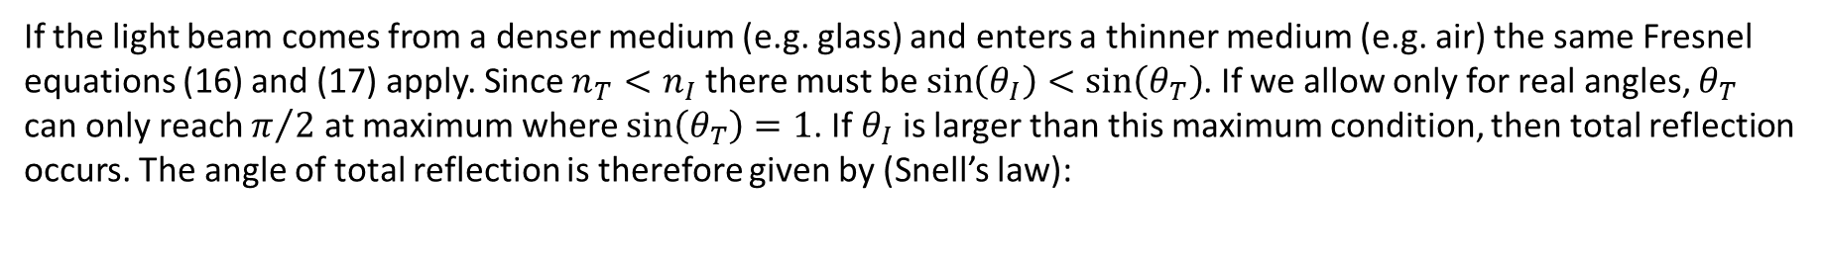






Total reflection
If the light beam comes from a denser medium (e.g. glass) and enters a thinner medium (e.g. air) the same Fresnel equations (16) and (17) apply. Since $n_{T}<n_{I}$ there must be $\sin\left(θ_{I}\right)<sin\left(θ_{T}\right)$. If we allow only for real angles, $θ_{T}$ can only reach $π/2$ at maximum where $sin\left(θ_{T}\right)=1$. If $θ_{I}$ is larger than this maximum condition, then total reflection occurs. The angle of total reflection is therefore given by (Snell’s law):
$sin\left(θ_{tot}\right)=\frac{n_{T}}{n_{I}}$
(20)
(for glass with $\frac{n_{T}}{n_{I}}=\frac{1}{1.5}$ , $θ_{tot}=41.8°$)
air
critical angle
total reflection
$$n_{T}$$
$$θ_{T}$$
?
$$n_{I}$$
$$θ_{1}$$
$$θ_{R}$$
$$θ_{tot}$$
$$θ_{I}$$
$$θ_{R}$$
glass

Slide 8





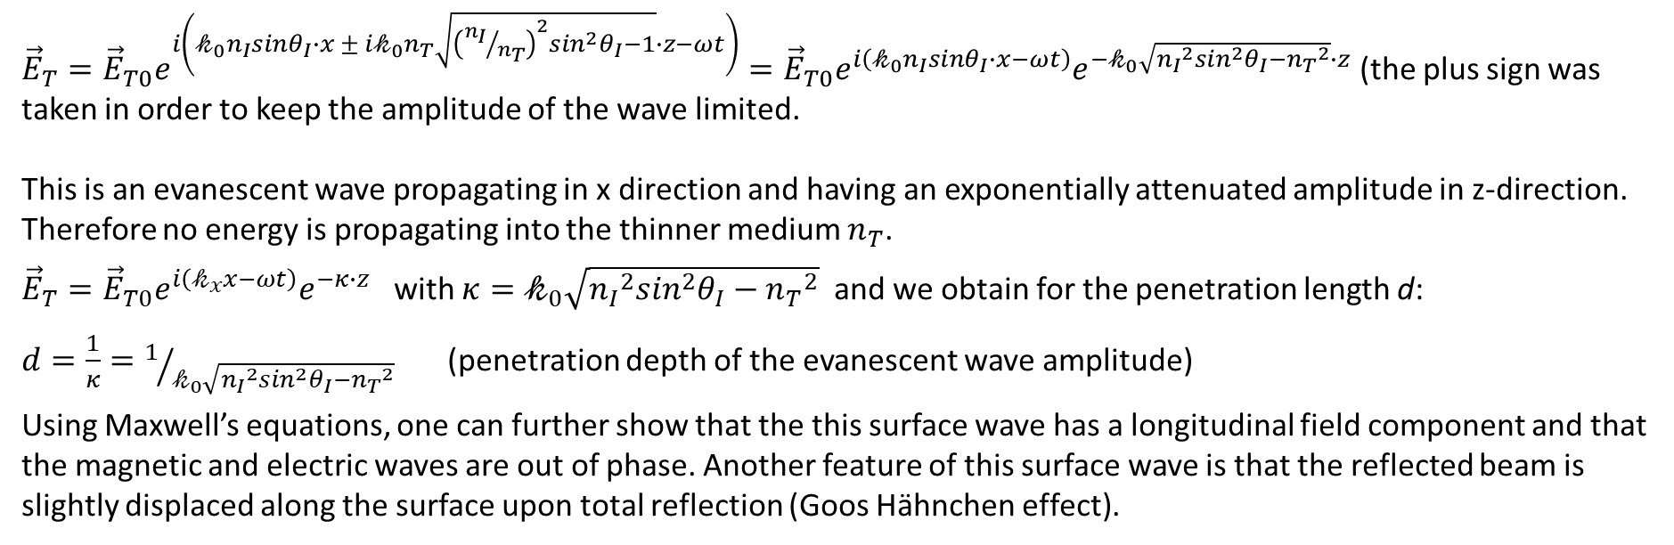



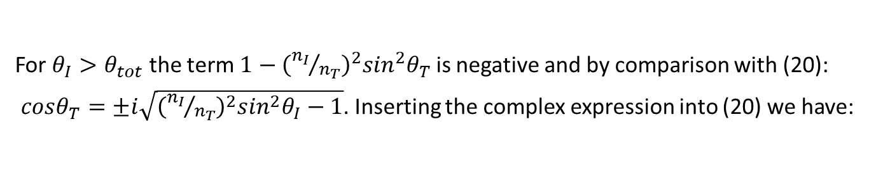
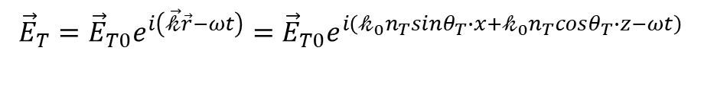


To understand the behavior of the electromagnetic radiation in the range of incident angles ${θ_{I}>θ}_{tot}$ complex angles have to be admitted for $θ_{T}$.
$$x$$
$${\vec{E}}_{T}={\vec{E}}_{T0}e^{i\left(\vec{𝓀}\vec{r}−ωt\right)}={\vec{E}}_{T0}e^{i\left(𝓀_{0}n_{T}sinθ_{T}∙x+𝓀_{0}n_{T}cosθ_{T}∙z−ωt\right)}$$
(20)
$${\vec{k}}_{T}$$
$𝓀_{0}=\frac{ω}{c}$. Using Snell’s law:
$${{\vec{E}}_{T}=\vec{E}}_{T0}e^{i\left(𝓀_{0}n_{I}sinθ_{I}∙x+𝓀_{0}n_{T}\sqrt{1−\sin^{2}θ_{T}}∙z−ωt\right)}={\vec{E}}_{T0}e^{i\left(𝓀_{0}n_{I}sinθ_{I}∙x+𝓀_{0}n_{T}\sqrt{1−{{\left({n_{I}}/{n_{T}}\right)}^{2}sin}^{2}θ_{I}}∙z−ωt\right)}$$
$$θ_{R}$$
$$θ_{T}$$
$$θ_{I}$$
$$z$$
$${\vec{k}}_{I}$$
For ${θ_{I}>θ}_{tot}$ the term$1−{{\left({n_{I}}/{n_{T}}\right)}^{2}sin}^{2}θ_{T}$ is negative and by comparison with (20):
$cosθ_{T}=±i\sqrt{{{\left({n_{I}}/{n_{T}}\right)}^{2}sin}^{2}θ_{I}−1}$. Inserting the complex expression into (20) we have:
$$n_{I}$$
$$n_{T}$$
${{\vec{E}}_{T}=\vec{E}}_{T0}e^{i\left(𝓀_{0}n_{I}sinθ_{I}∙x ± i{𝓀_{0}n}_{T}\sqrt{{{\left({n_{I}}/{n_{T}}\right)}^{2}sin}^{2}θ_{I}−1}∙z−ωt\right)}={{\vec{E}}_{T0}e}^{i\left(𝓀_{0}n_{I}sinθ_{I}∙x−ωt\right)}e^{−𝓀_{0}\sqrt{{{n_{I}}^{2}sin}^{2}θ_{I}−{n_{T}}^{2}}∙z}$ (the plus sign was taken in order to keep the amplitude of the wave limited.
This is an evanescent wave propagating in x direction and having an exponentially attenuated amplitude in z-direction. Therefore no energy is propagating into the thinner medium $n_{T}$.
${\vec{E}}_{T}={{\vec{E}}_{T0}e}^{i\left(𝓀_{x}x−ωt\right)}e^{−κ∙z}$ with $κ=𝓀_{0}\sqrt{{{n_{I}}^{2}sin}^{2}θ_{I}−{n_{T}}^{2}}$ and we obtain for the penetration length d:
$d=\frac{1}{κ}=1/{𝓀_{0}\sqrt{{{n_{I}}^{2}sin}^{2}θ_{I}−{n_{T}}^{2}}}$ (penetration depth of the evanescent wave amplitude)
Using Maxwell’s equations, one can further show that the this surface wave has a longitudinal field component and that the magnetic and electric waves are out of phase. Another feature of this surface wave is that the reflected beam is slightly displaced along the surface upon total reflection (Goos Hähnchen effect).

Slide 9
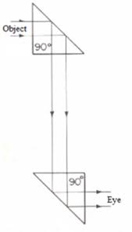
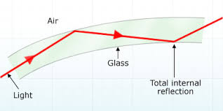
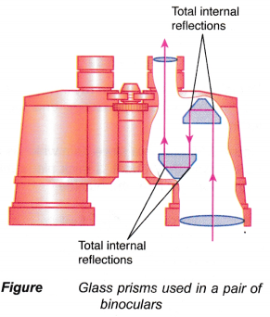
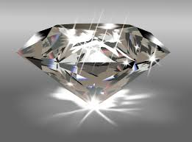
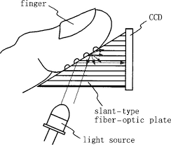
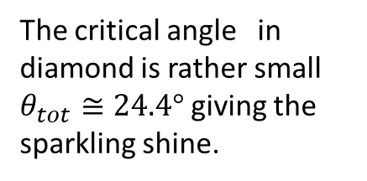
Applications of total reflection
Binoculars
Periscope
Optical fibre
Fingerprint/ Humidity sensor
Diamond
The critical angle in diamond is rather small $θ_{tot}≅24.4°$ giving the sparkling shine.

Slide 10







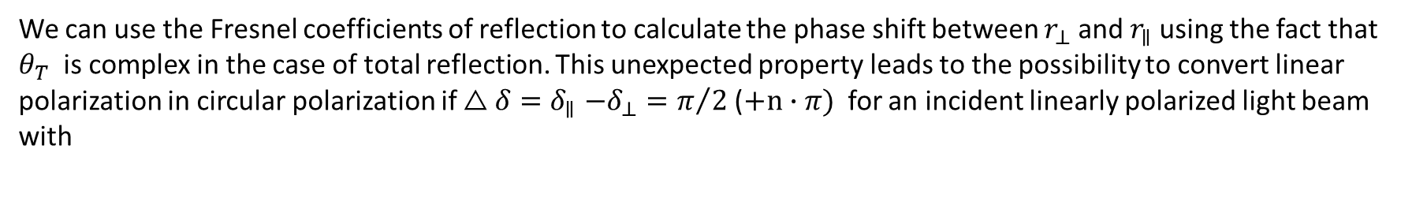







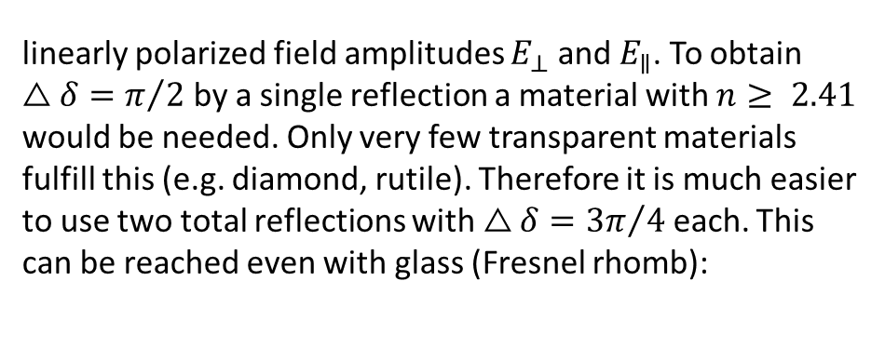



Phase shift upon total reflection
We can use the Fresnel coefficients of reflection to calculate the phase shift between $r_{⊥}$ and $r_{∥}$ using the fact that $θ_{T}$ is complex in the case of total reflection. This unexpected property leads to the possibility to convert linear polarization in circular polarization if $△δ{=δ}_{∥}−δ_{⊥}=π/2$ ($+n∙π)$ for an incident linearly polarized light beam with
linearly polarized field amplitudes $E_{⊥}$ and $E_{∥}$. To obtain $△δ=π/2$ by a single reflection a material with $n≥ 2.41$ would be needed. Only very few transparent materials fulfill this (e.g. diamond, rutile). Therefore it is much easier to use two total reflections with $△δ={3π}/4$ each. This can be reached even with glass (Fresnel rhomb):
$$π$$
$$△δ=δ_{∥}−δ_{⊥}$$
$$3π/4$$
phase $δ$
$$π/2$$
$$δ_{⊥}+π$$
$$π/4$$
$$δ_{∥}$$
$$δ_{∥}$$
$${\vec{E}}_{I}$$
$$0$$
$$δ_{⊥}$$
$$0°$$
$$θ_{B}$$
$$θ_{tot}$$
$$90°$$
angle of incidence $θ_{I}$ (°)

Slide 11

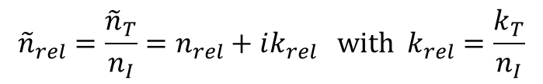
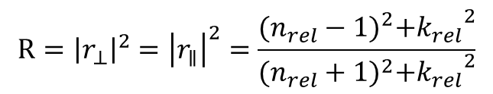
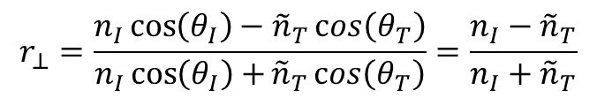
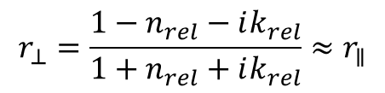
Absorbing Media
In absorbing media and particularly also in metals, Fresnel’s laws for reflection and absorption are still valid. However ${\tilde{n}}_{T}$ now is complex. If we take the reflection at the interface between a thin and transparent medium $n_{I}$ and an absorbing medium ${\tilde{n}}_{T}=n_{T}+i k_{T}$ we can write for small angles $θ_{I}$and $θ_{T}$ (equation 16’):
$$r_{⊥}=\frac{n_{I}\cos\left(θ_{I}\right)−{\tilde{n}}_{T}\cos\left(θ_{T}\right)}{n_{I}\cos\left(θ_{I}\right)+{\tilde{n}}_{T}\cos\left(θ_{T}\right)}=\frac{n_{I}−{\tilde{n}}_{T}}{n_{I}+{\tilde{n}}_{T}}$$
$${\tilde{n}}_{rel}=\frac{{\tilde{n}}_{T}}{n_{I}}=n_{rel}+ik_{rel} with k_{rel}=\frac{k_{T}}{n_{I}}$$
Defining a relative complex refractive index ${\tilde{n}}_{rel}$:
we obtain:
$$r_{⊥}=\frac{1−n_{rel}−ik_{rel}}{1+n_{rel}+ik_{rel}}≈r_{∥}$$
and hence:
$$R={\left|r_{⊥}\right|}^{2}={\left|r_{∥}\right|}^{2}=\frac{{(n_{rel}−1)}^{2}+{k_{rel}}^{2}}{{(n_{rel}+1)}^{2}+{k_{rel}}^{2}}$$
(21)
It can be seen that strong reflection also occurs for wavelength regions where the medium absorbs strongly. ($k_{rel}≥1$).

Slide 12
dye coated on plastic foil

Slide 13
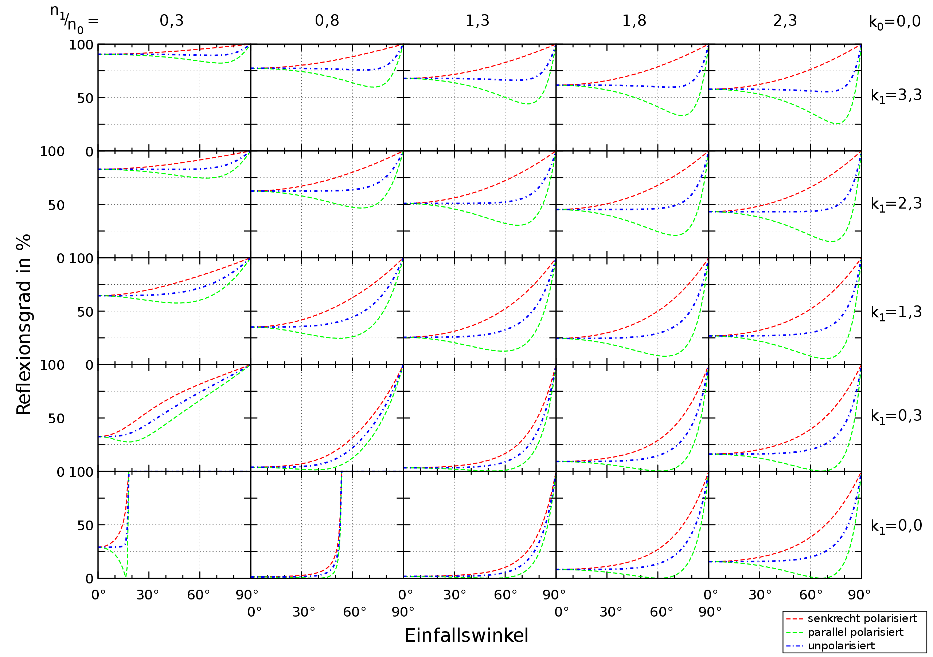


Fresnel Reflection at the interface between air and an absorbing medium (k≠0)
reflection (%)
$${\vec{E}}_{⊥}$$
unpolarized
$${\vec{E}}_{∥}$$
angle of incidence

